Slide 1
Build Your Own Android OS!
Present By: Ahmad Haris

Slide 2
About Me
Ahmad Haris | @princeofgiri
Linux Evangelist, Open Source Enthusiast,
Membership Committee of Document Foundation
Contact:
me@princeofgiri.com

Slide 3

Demo Machine
OS:
Ubuntu 20.04
CloudVM provided by CloudKilat:
32 Core vCPU
32 GB RAM
320 GB Storage

Slide 4
Dependencies
bc bison build-essential ccache curl flex g++-multilib gcc-multilib git gnupg gperf imagemagick lib32ncurses5-dev lib32readline-dev lib32z1-dev libelf-dev liblz4-tool libncurses5 libncurses5-dev libsdl1.2-dev libssl-dev libxml2 libxml2-utils lzop pngcrush rsync schedtool squashfs-tools xsltproc zip zlib1g-dev libwxgtk3.0-gtk3-dev

Slide 5
Install Platform Tools
wget https://dl.google.com/android/repository/platform-tools-latest-linux.zip
unzip platform-tools-latest-linux.zip -d ~
Add to .bashrc or .profile
# add Android SDK platform tools to path
if [ -d "$HOME/platform-tools" ] ; then
PATH="$HOME/platform-tools:$PATH"
fi

Slide 6
Prepare Directory
mkdir -p ~/bin
mkdir -p ~/android/nenggala

Slide 7
Install repo tools
curl https://storage.googleapis.com/git-repo-downloads/repo > ~/bin/repo
chmod a+x ~/bin/repo
Add to .bashrc or .profile
# set PATH so it includes user's private bin if it exists
if [ -d "$HOME/bin" ] ; then
PATH="$HOME/bin:$PATH"
fi

Slide 8
Configure Git
git config --global user.email "you@example.com"
git config --global user.name "Your Name"

Slide 9
Sync Repo
$ cd ~/android/nenggala
Nenggala
repo init -u git@github.com:nenggala-project/android.git -b 11.1
LineageOS
repo init -u https://github.com/LineageOS/android.git -b lineage-19.1

Slide 10
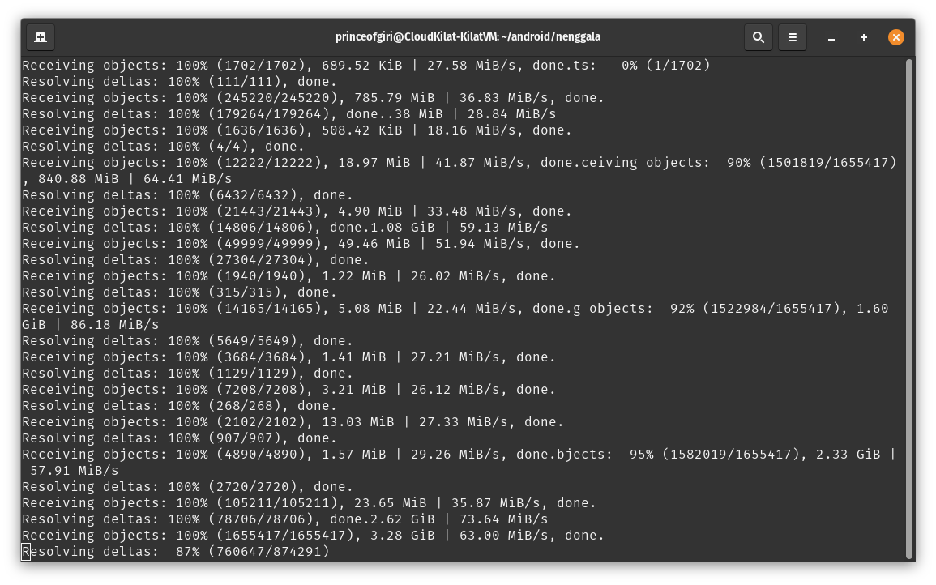
$ repo sync

Slide 11
Build!
$ source build/envsetup.sh
$ breakfast <devicename>
$ breakfast alioth
$ brunch alioth

Slide 12
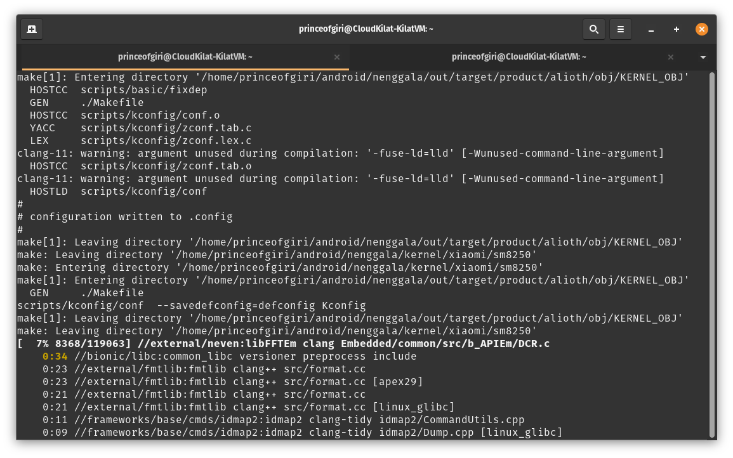
Compiling ….

Slide 13
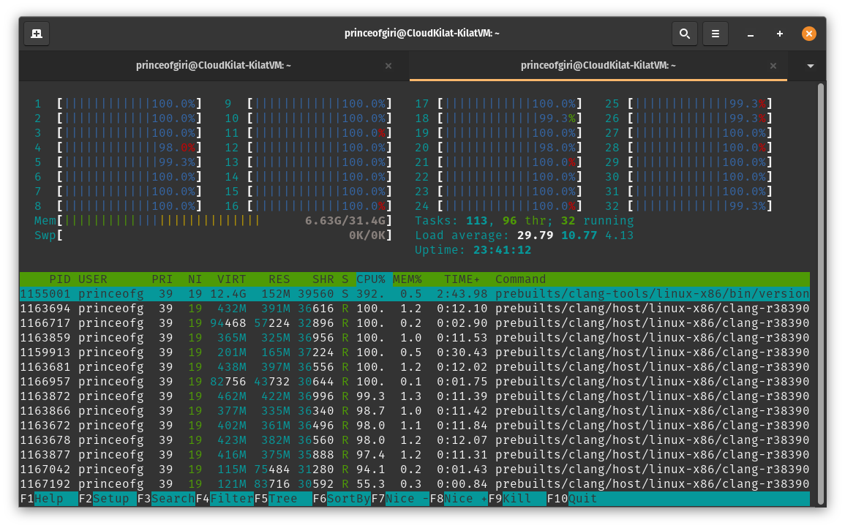

Slide 14
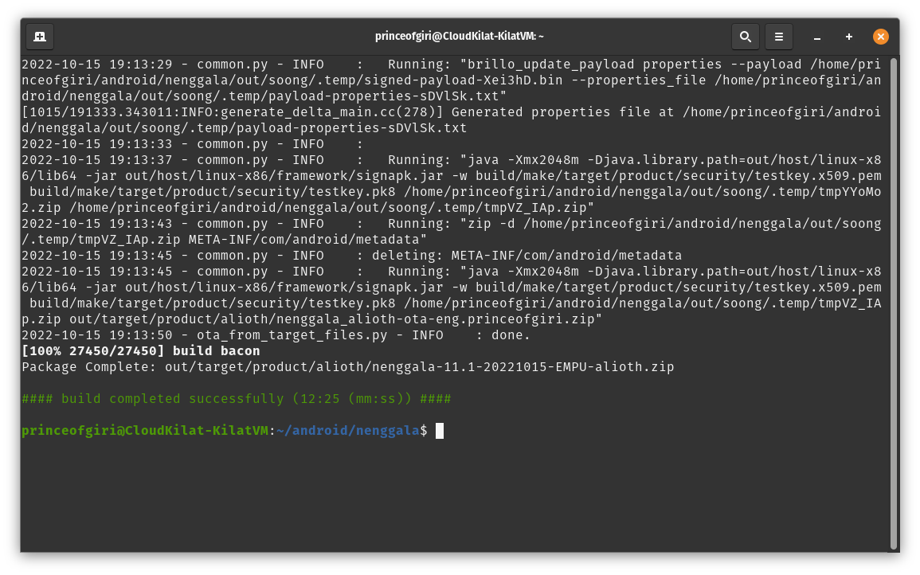
The result when you’re kind person =))

Slide 15
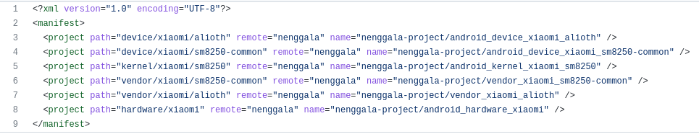
$ brunch <devicename>

Slide 16
Device Code
https://github.com/nenggala-project/android_device_xiaomi_alioth

Slide 17
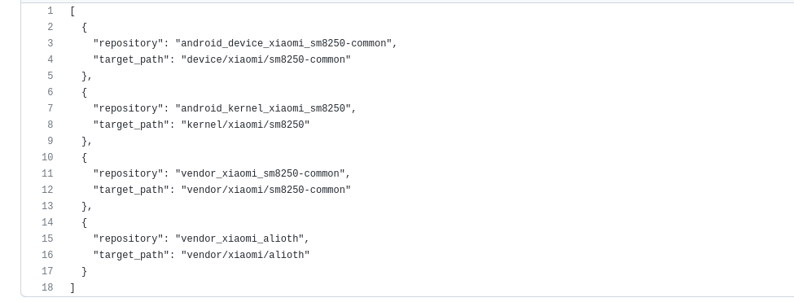
Device Dependencies

Slide 18
Reason
It extends your phone’s lifespan
Remove bloated OS (unwanted built-in apps)
It’s a great way to de-Google your device
Have good and powerfull machine and nothing to do
Have lot of spare time
Somebody ask you to do

Slide 19

Thank you

https://www.ilc.opensuse.id

